Slide 1
GSE138852 Analysis/Tutorial
By: Harsh Duvvuru

Slide 2
Understanding the GSE138852 dataset

Slide 3

What is in the GSE138852 dataset?
The date consists of the entorhinal cortex from control and AD brains of twelve individuals, yielding a total of 13,214 high quality nuclei.
*AD brains are brains which have had Alzheimer’s disease
Resource used: https://www.ncbi.nlm.nih.gov/geo/query/acc.cgi?acc=GSE138852

Slide 4
Research paper brief analysis
The research paper written about this dataset is titled “A single-cell atlas of entorhinal cortex from individuals with Alzheimer’s disease reveals cell-type-specific gene expression regulation.” Here are the key points
A molecular survey of the human Alzheimer’s disease brain was conducted
Various methods were used during the survey
File title: grubman2019 on box
Payed link: https://www.nature.com/articles/s41593-019-0539-4
Box link: https://iu.app.box.com/file/683797590132

Slide 5
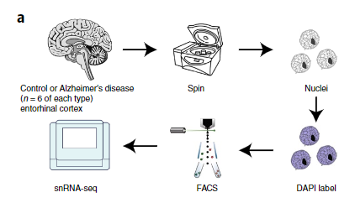
Figure A from the research paper
(Overall workflow)

Slide 6
Basic Analysis using R

Slide 7
Getting started
There are two ways to use the GSE138852 dataset. Once you have the R workspace (Rdata) file for that dataset you can either directly open it from the file to proceed with ls() or you can open an empty R workspace. Once you open this workspace you have to load in the dataset.
I decided to go with option one. You will see that I do not use the above code in the next slide. What “ls()” does is it lists the data sets and functions that were in the loaded dataset (data_GSE138852.rdata).
This is how the code would look if you decided to load in the dataset.
setwd("dataset location")
load("data_GSE138852.rdata")

Slide 8
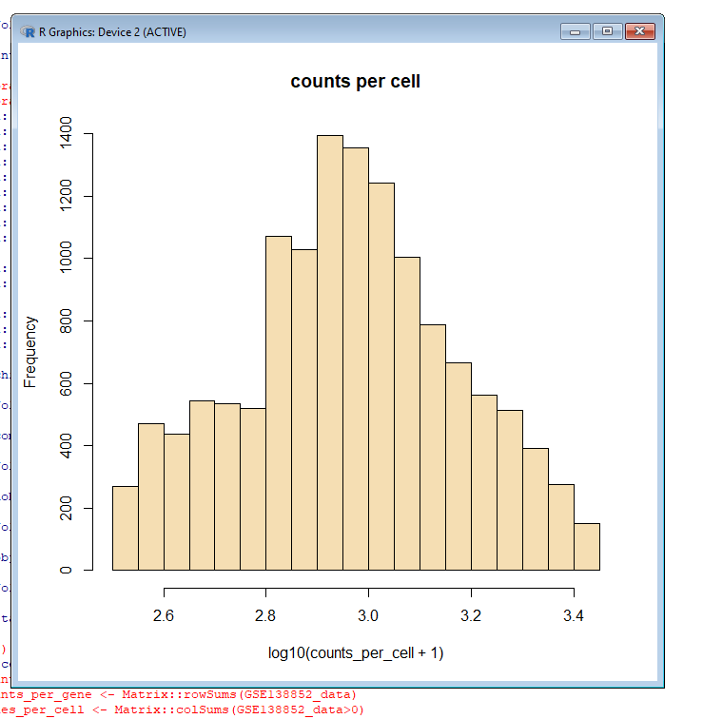
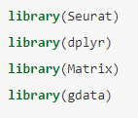
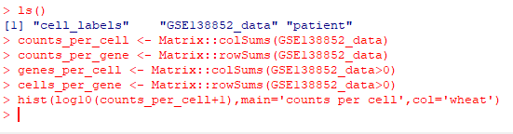
First off I wanted to play around with the data
1)
3)
2)
*I created some other graphs I did not put them
In the powerpoint

Slide 9
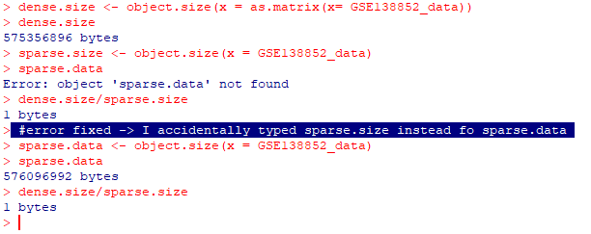
Next I examined the memory savings between regular and sparse matrices

